Slide 1

Marketing Retail & Analysis Project - 1
By: Kavin Bharathi V
vkavinbharathi@gmail.com
Notes:
To change the image on this slide, select the picture and delete it. Then click the Pictures icon in the placeholder to insert your own image.

Slide 2
Table of Contents
Problem Statement
Exploratory Data Analysis
RFM Analysis
Customer Segmentation
Recommendations

Slide 3
Problem Statement
An automobile parts manufacturing company has collected data on transactions for 3 years.
They do not have any in-house data science team, thus they have hired you as their consultant.
Your job is to use your data science skills to find the underlying buying patterns of the customers, provide the company with suitable insights about their customers, and recommend customized marketing strategies for different segments of customers.

Slide 4
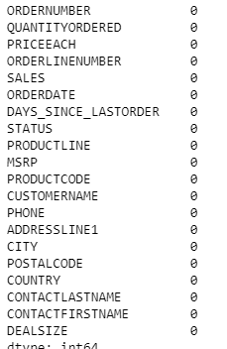
Exploratory Data Analysis
Data Summary:
The data contains 2747 rows and 20 columns.
The data doesn’t have any null values or duplicates.

Slide 5
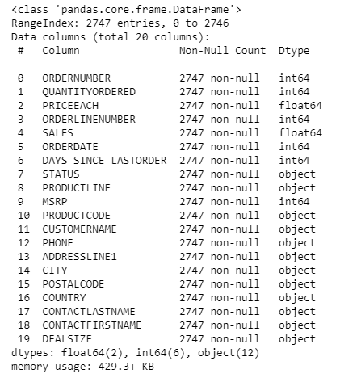
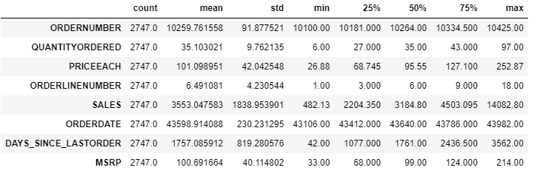
Exploratory Data Analysis
Data Info & Description:

Slide 6
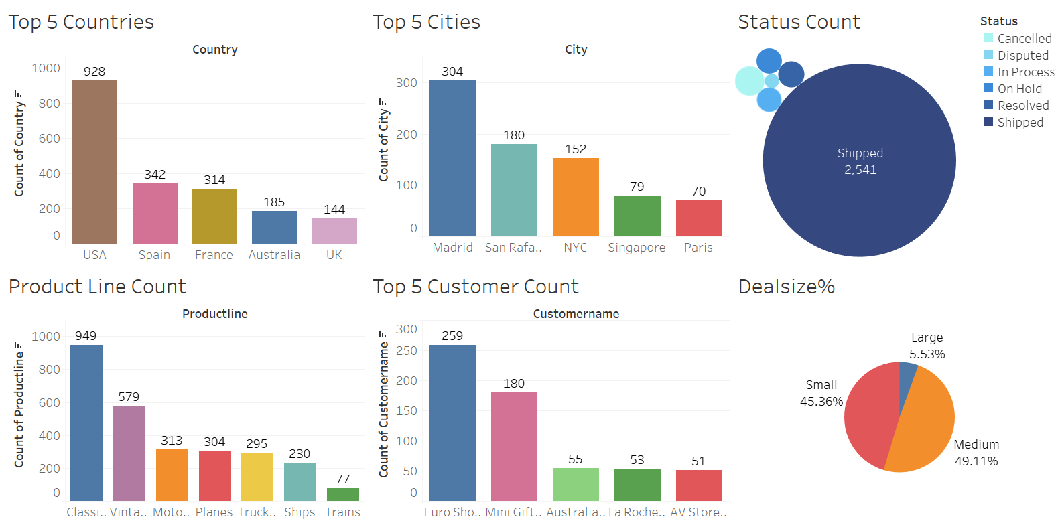
Unique Values and counts

Slide 7
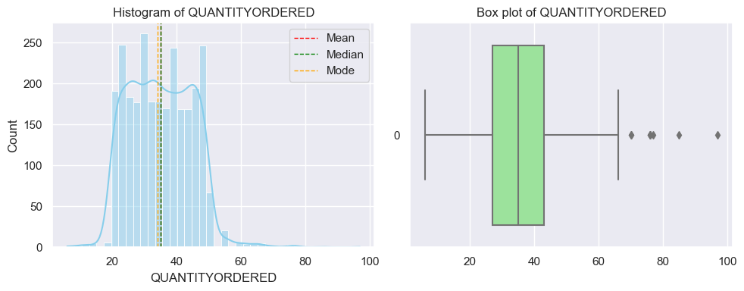
Univariate Analysis
Quantity Ordered

Slide 8
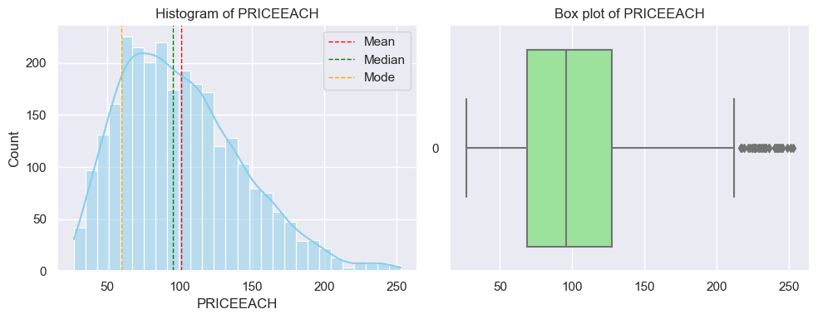
Univariate Analysis
Price Each:

Slide 9
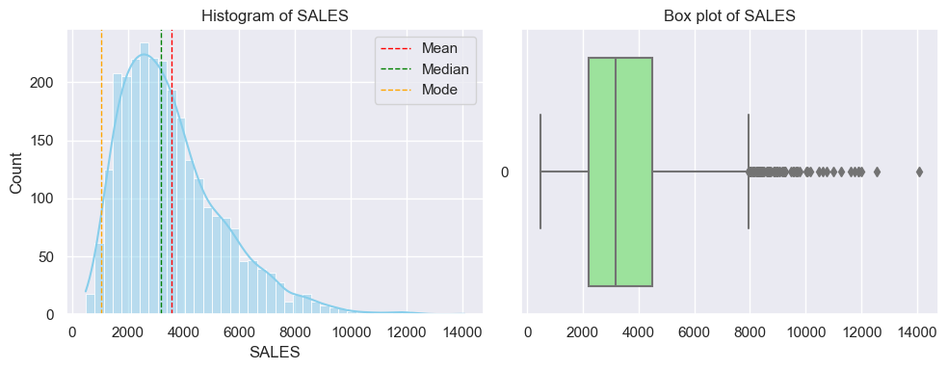
Univariate Analysis
Sales:

Slide 10
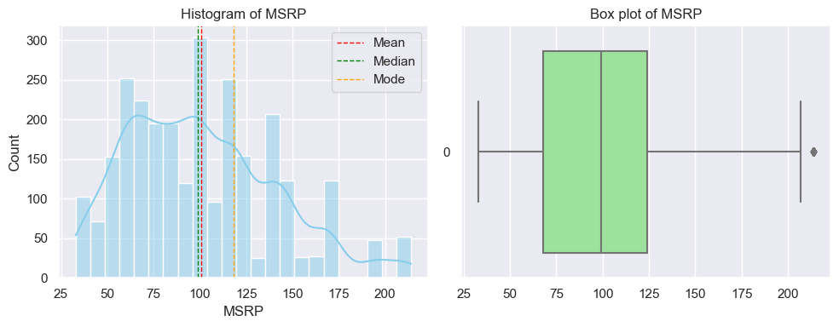
Univariate Analysis
MSRP

Slide 11
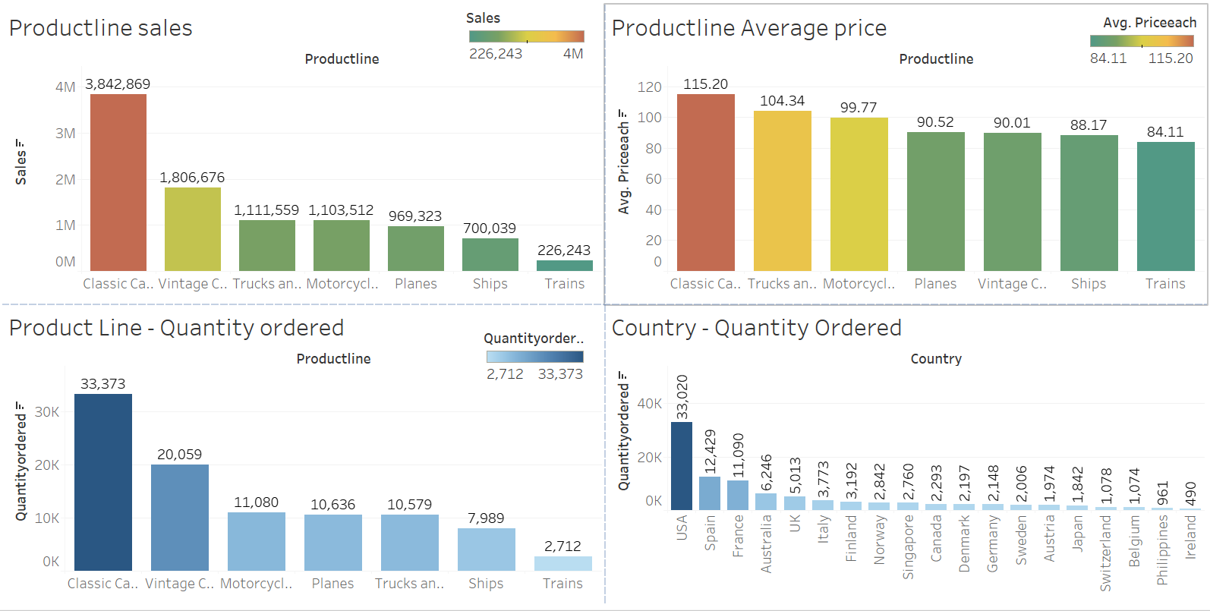
Bivariate Analysis

Slide 12
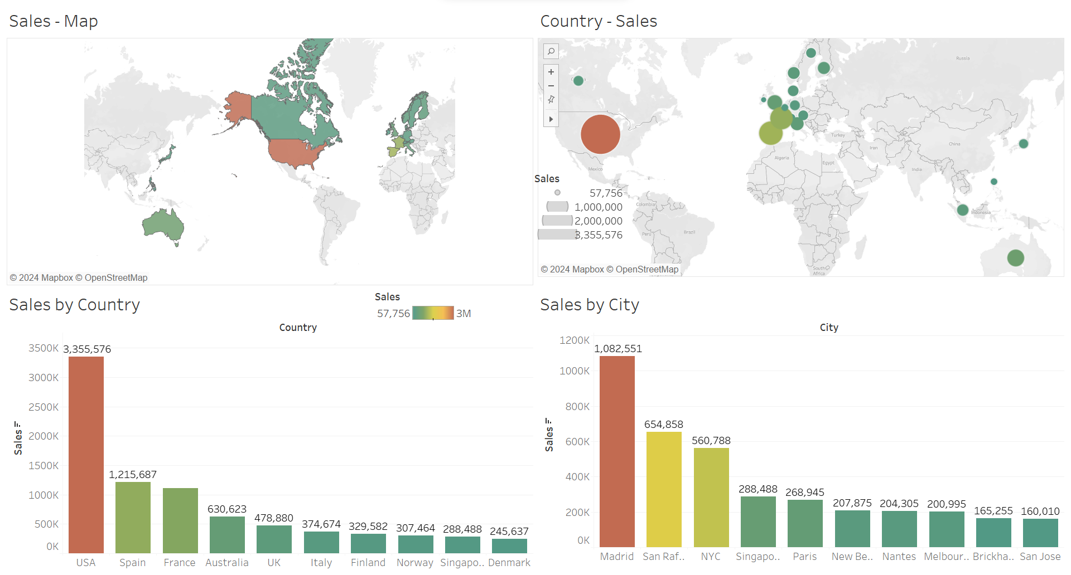

Slide 13
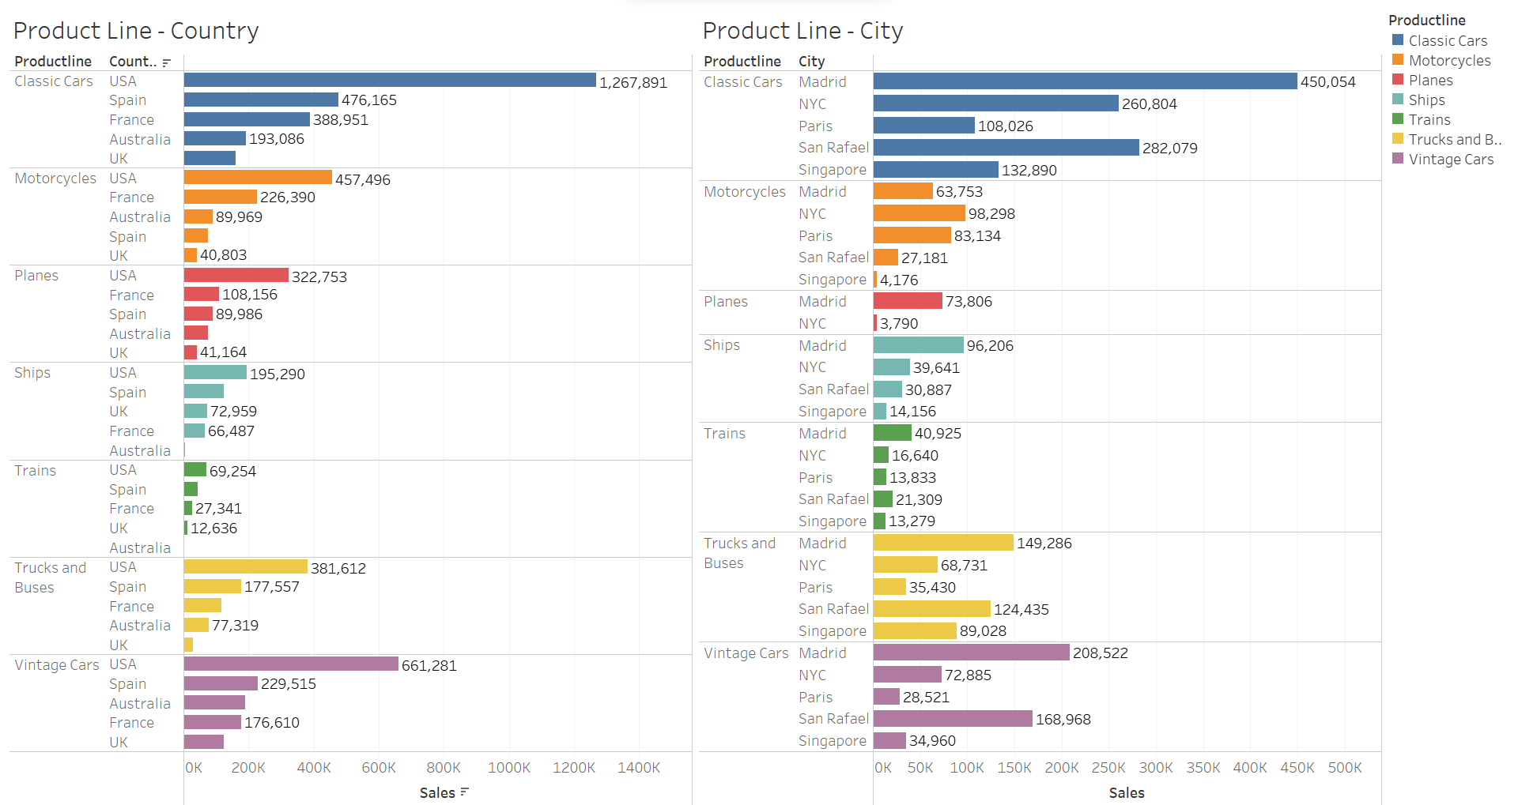

Slide 14
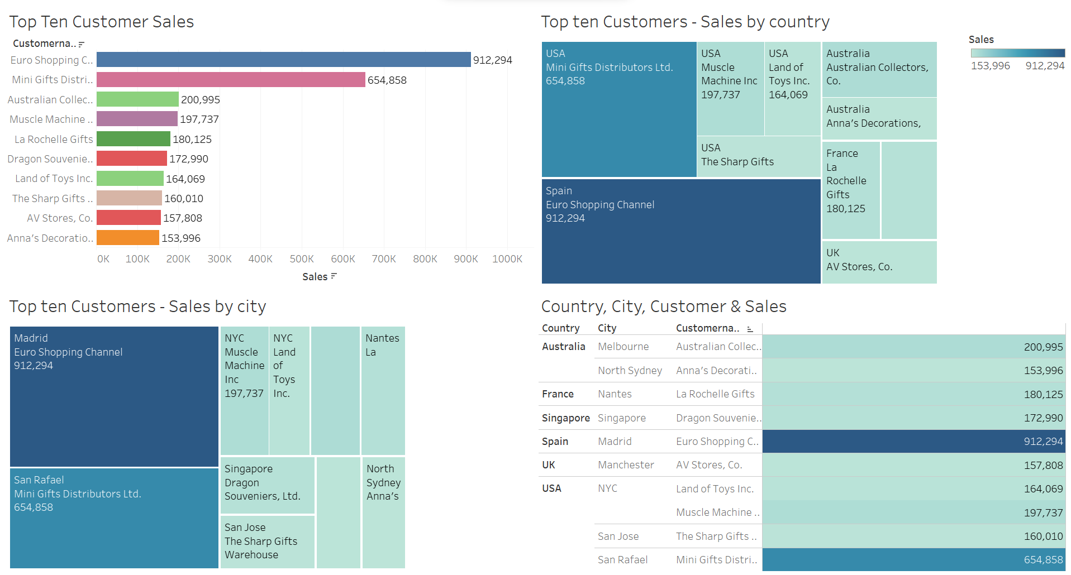

Slide 15
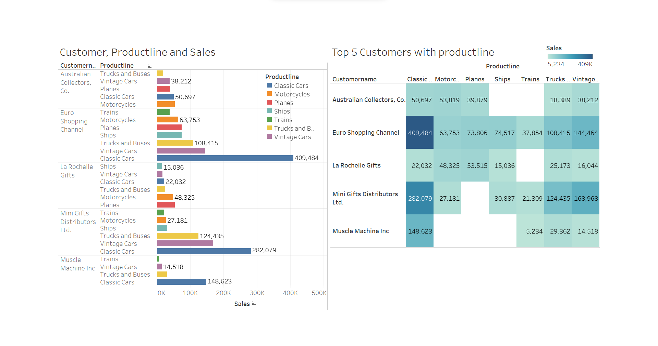

Slide 16
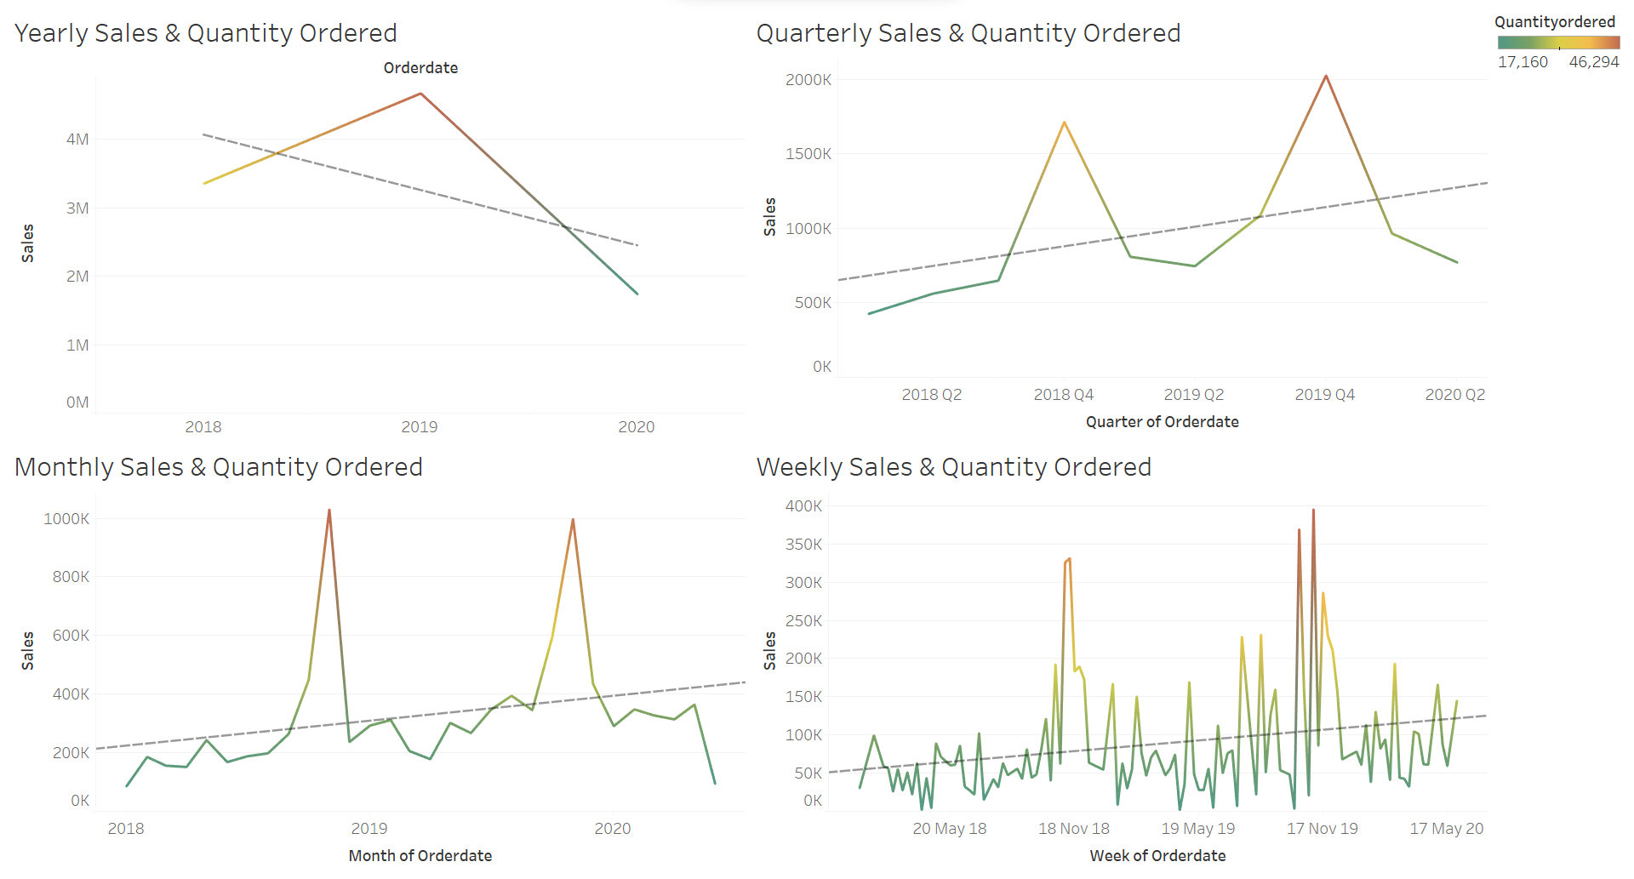
Title and Content Layout with SmartArt

Slide 17
EDA Summary and Inferences
Classic cars represent the highest number of units sold and generate the most sales revenue.
Planes, trucks, and ships typically have the longest order queues.
The United States and Spain are the leading countries in terms of sales volume. In the US, San Rafael and NYC are the top-selling cities, while Madrid dominates the market in Spain.
The Euro Shopping Channel and Mini Gifts Distributor stand out as the largest customers.
Classic cars are the top-selling products for both Euro Shopping and Mini Gifts.
While overall yearly sales show a decline, a closer examination reveals a gradual upward trend.

Slide 18
RFM
RFM analysis categorizes customers based on Recency, Frequency, and Monetary Value.
Utilizing RFM analysis, customers are categorized into four segments: High-Value, Mid-Value, At-Risk/Potential, and Churn, facilitated by a KNIME workflow.
Initially, Recency, Frequency, and Monetary columns were established to segment customers accordingly.
High and mid-valued customers are deemed loyal, while at-risk customers hold potential for conversion to mid-value through tailored promotional strategies.
Conversely, customers identified as Churn may be allowed to discontinue their engagement.

Slide 19
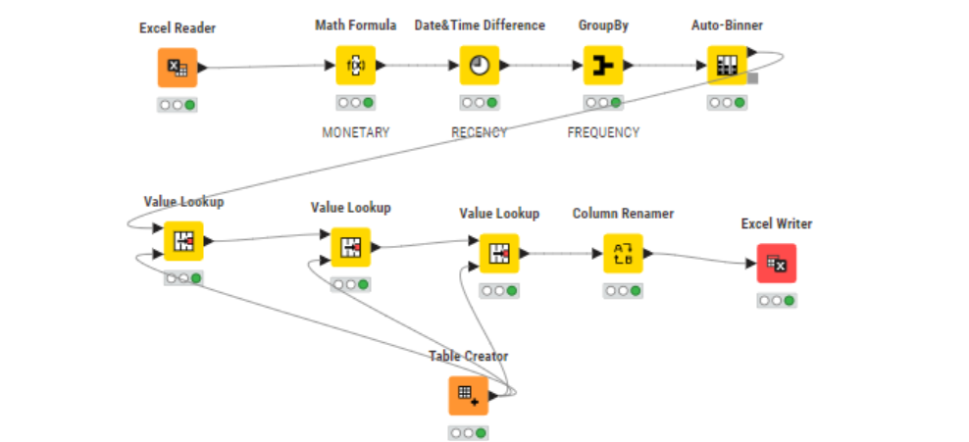
Knime Workflow

Slide 20
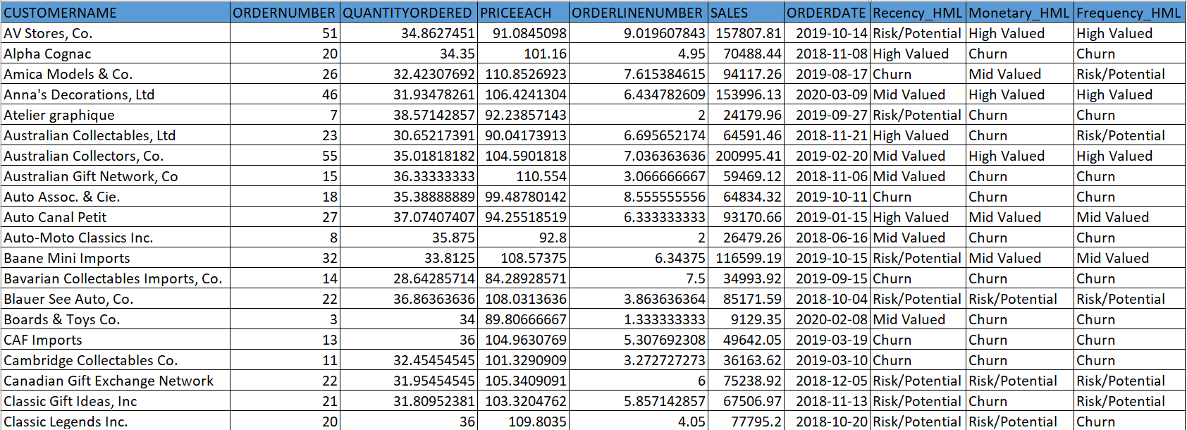
Segmented Table

Slide 21
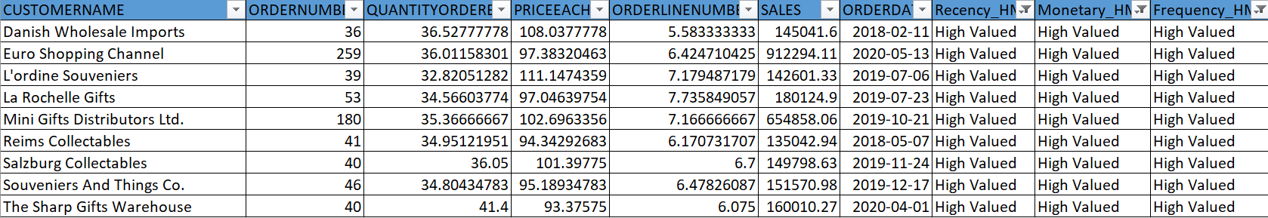
RFM Inferences
Best Customers

Slide 22
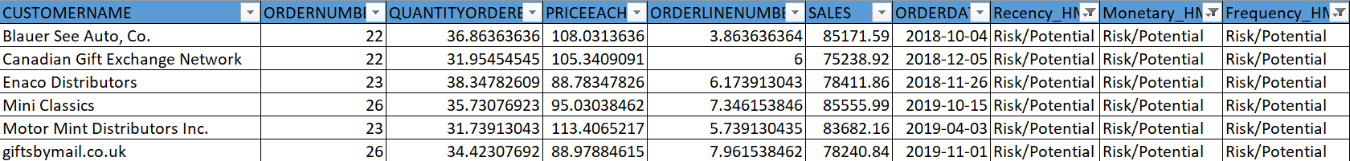
RFM Inferences
Risk/Potential Customers

Slide 23
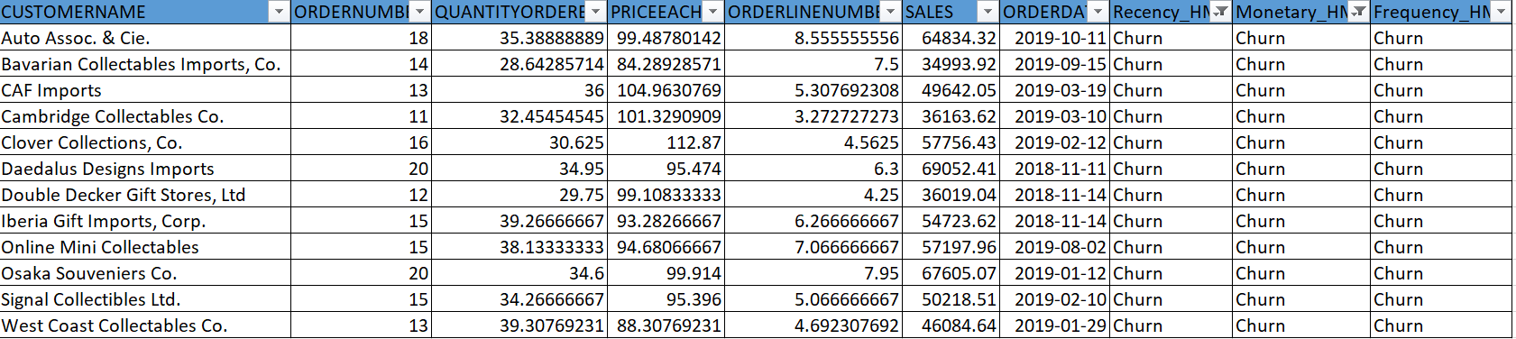
RFM Inferences
Lost Customers

Slide 24
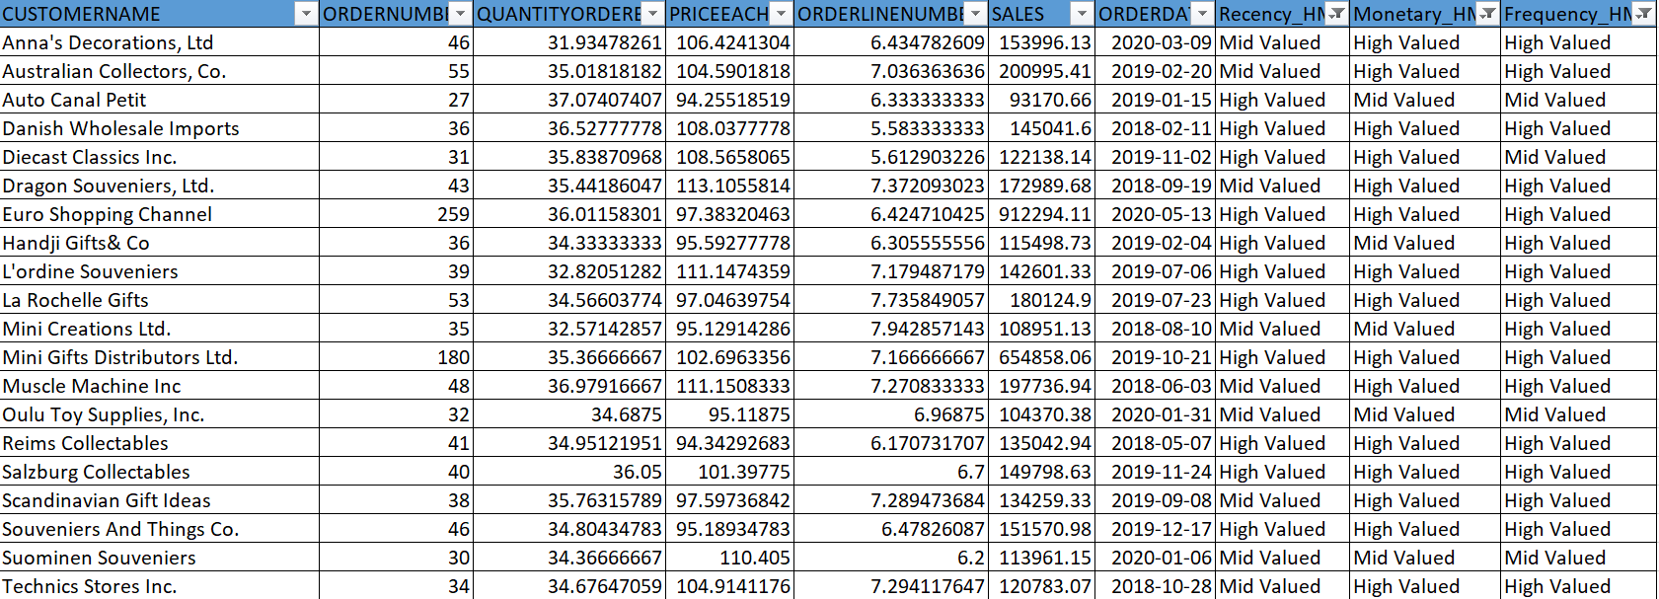
RFM Inferences
Loyal Customers

Slide 25
Thank You

